Slide 1
T311- Material Handler Robot
EEL4911C
VDR5
08-March-21

Slide 2


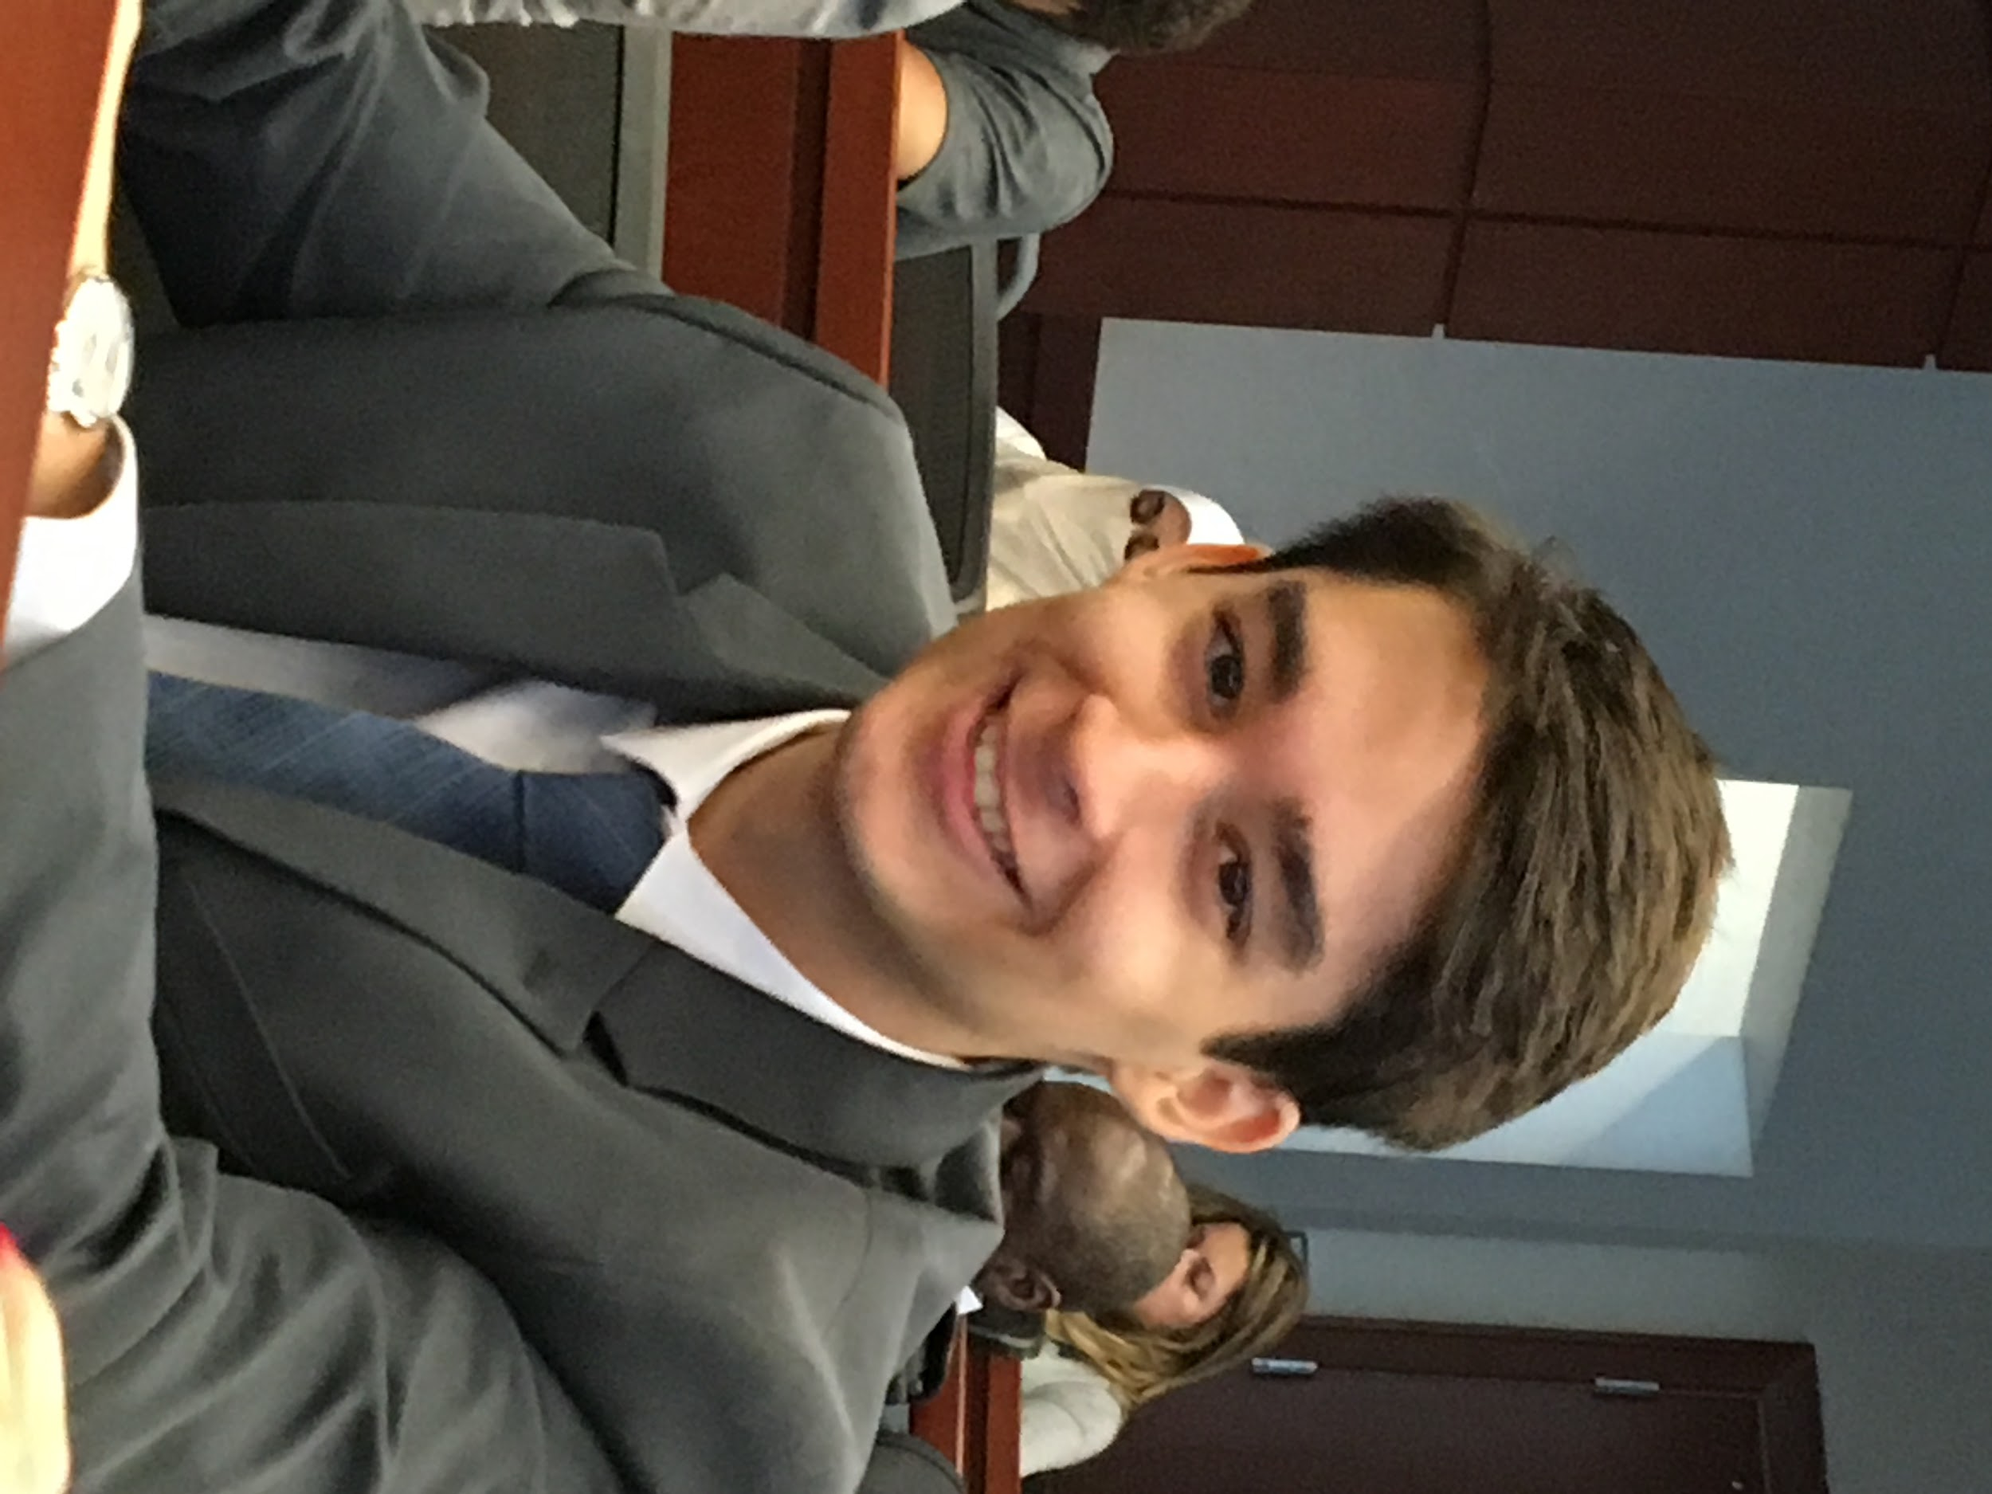



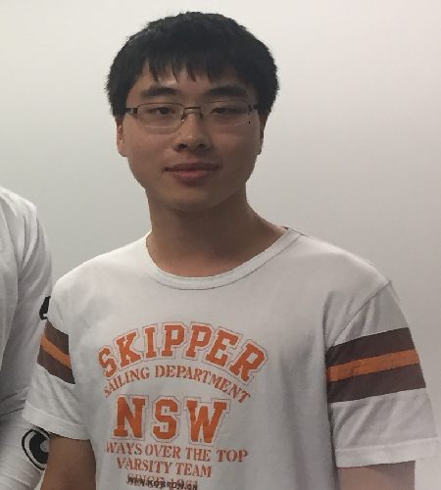
Team Introductions
WALTER CALDWELL
Project Technical Manager
TIFFANY
MILLER
Hardware Co-lead Engineer
SEBASTIAN MURIEL
Hardware Co-Lead Engineer
ALEX JEN
Software Co-Lead Engineer
TONY ZHENG
Software Co-Lead Engineer

Slide 3





ME Senior Design Team 506
NICHOLAS NORWOOD
Controls Engineer
PETER WATSON
Materials Engineer
DIANDRA REYES
Additive Manufacturing Engineer
ALEXANDER WOZNY
Systems Engineer
TAYLOR HARVEY
Mechanical Design Engineer

Slide 4




Outline
Project Recap
Updates
&
Results
Future Work
Questions
Objective
Key Goals
Parts Ordered
Completed Modules
Project Website
Challenges
Future Plans
GANTT Chart

Slide 5

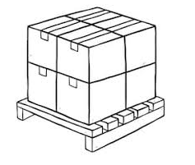
Objective
The objective of this project is to create a partially autonomous material handling robot that works in a dark warehouse with conditions unfavorable to human workers.

Slide 6
Key Goals
Autonomous navigation of the modified warehouse.
Pick up and move boxes up to 25 lbs.
Identify packages using QR codes.
Track inventory using QR codes.
Be able to perform the key tasks in a modified warehouse with low lighting.
Notes:
Explicitly state that these are the minimum requirements for the robot to be considered a success.

Slide 7
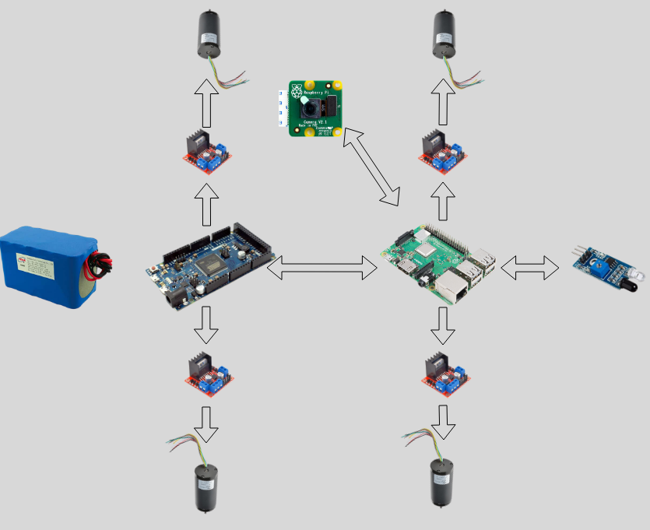
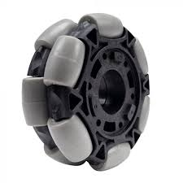
Ordering Parts
Every week new parts are coming in.
Ordering new parts:
Arduino Nanos, Due
Pi 4
ME parts
etc.
Notes:
Explicitly state that these are the minimum requirements for the robot to be considered a success.

Slide 8

Currently Completed Modules
Testing of each of the parts:
Pi Camera with OpenCV
Pi Camera rotating stand
MongoDB
Motor Driver L29-H-bridge
Ultrasonic Sensor
Webmaster website functions are complete
Notes:
Explicitly state that these are the minimum requirements for the robot to be considered a success.

Slide 9
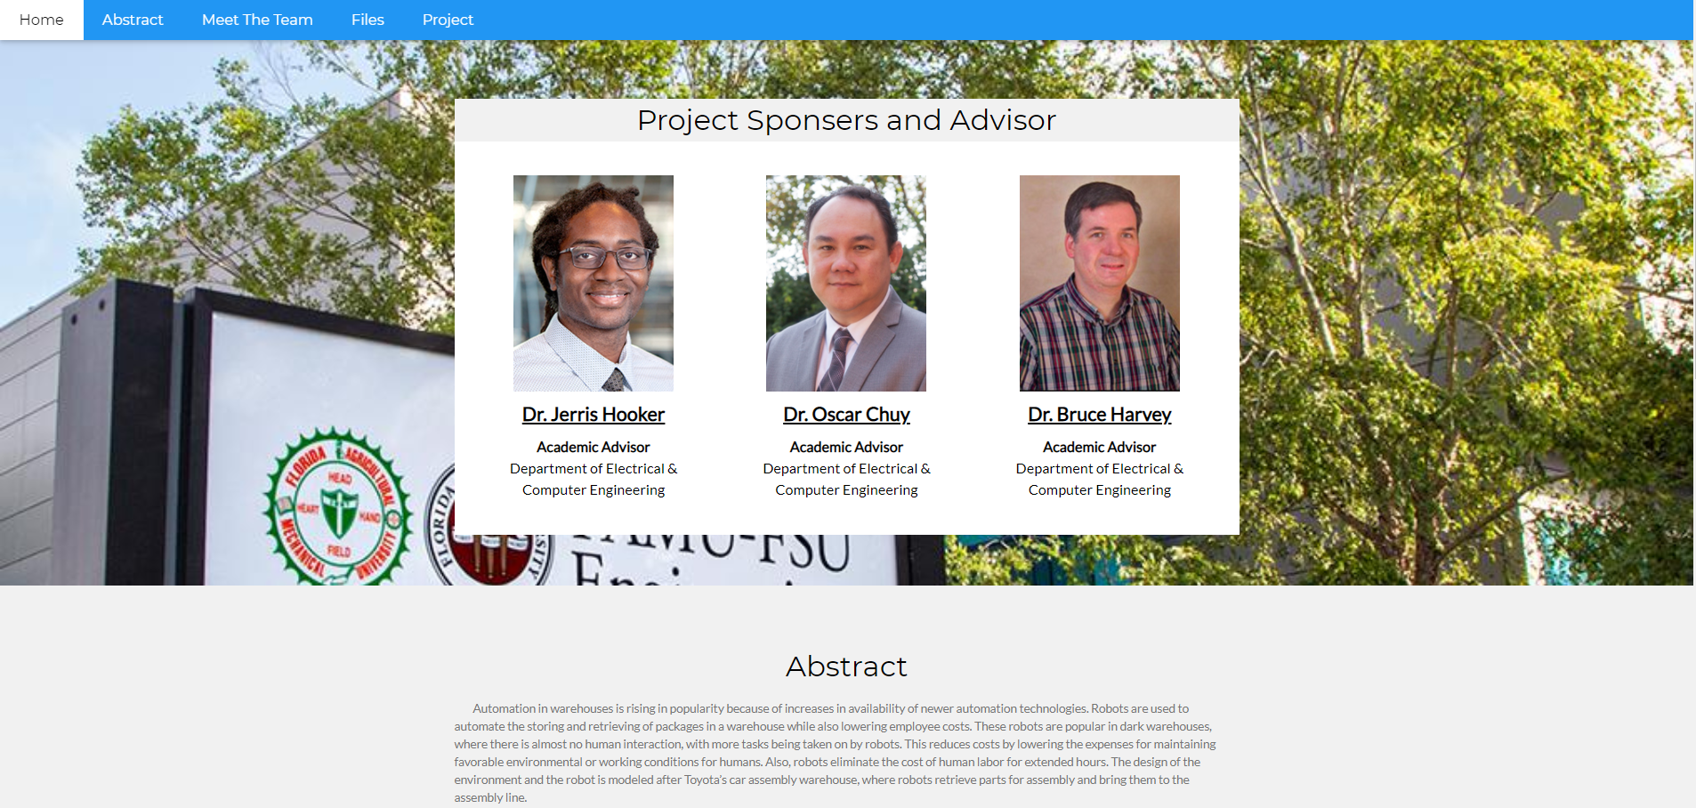
Project Website
Alexandar Jen

Slide 10

Challenges
Important parts have not arrived.
Testing the battery source on the motor controllers burned some arduinos.
MongoDB not working on Pi OS, only works on Ubuntu. Might need a Pi 4.
Notes:
Explicitly state that these are the minimum requirements for the robot to be considered a success.

Slide 11
Future Plans
Front-end and back-end of website to take user inputs
Testing wheels
Integrating functions together
Pi OpenCV -> MongoDB
Website -> MongoDB -> Pi
Pi <-> Arduino Due
Develop PID system
Develop and research path finding system
Continue developing with ME Team
Notes:
Explicitly state that these are the minimum requirements for the robot to be considered a success.

Slide 12
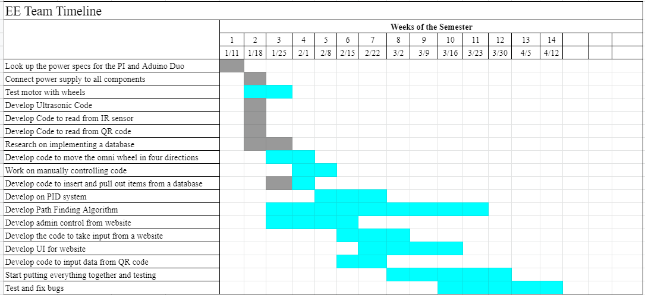
Updated GANTT Chart
Old
Notes:
Explicitly state that these are the minimum requirements for the robot to be considered a success.

Slide 13
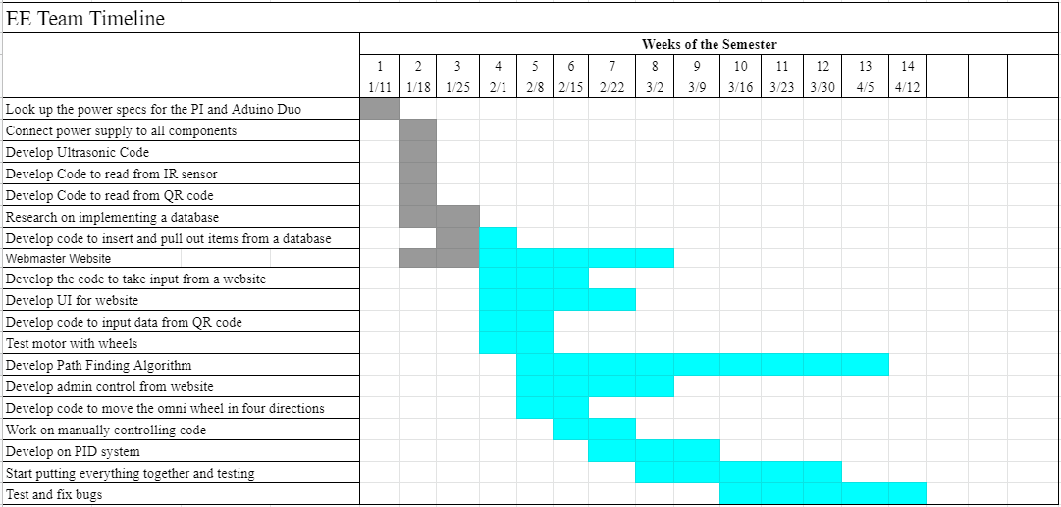
Updated GANTT Chart
New
Notes:
Explicitly state that these are the minimum requirements for the robot to be considered a success.

Slide 14

Questions

